Slide 1
How to form a mental health dataset: a glimpse into different models
Ruichen MA, Sibo ZHAO

Slide 2
Why dataset is important?
Baseline LLMs are the same (mostly ChatGPT)
Training data and prompting matter
Hard to retrieve authentic data

Slide 3
Three aspects of a dataset
Data source
Data processing
Display/Analysis of examples

Slide 4
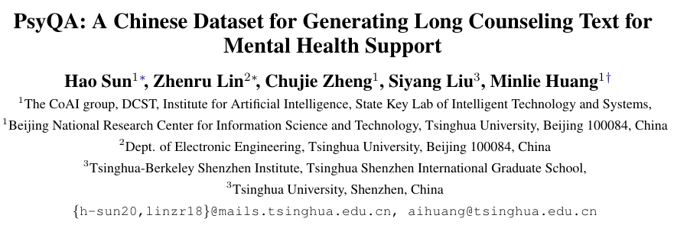
Data source
For Chinese models, the range of data source is narrow.
The psyQA dataset is crawled from Yixinli

Slide 5
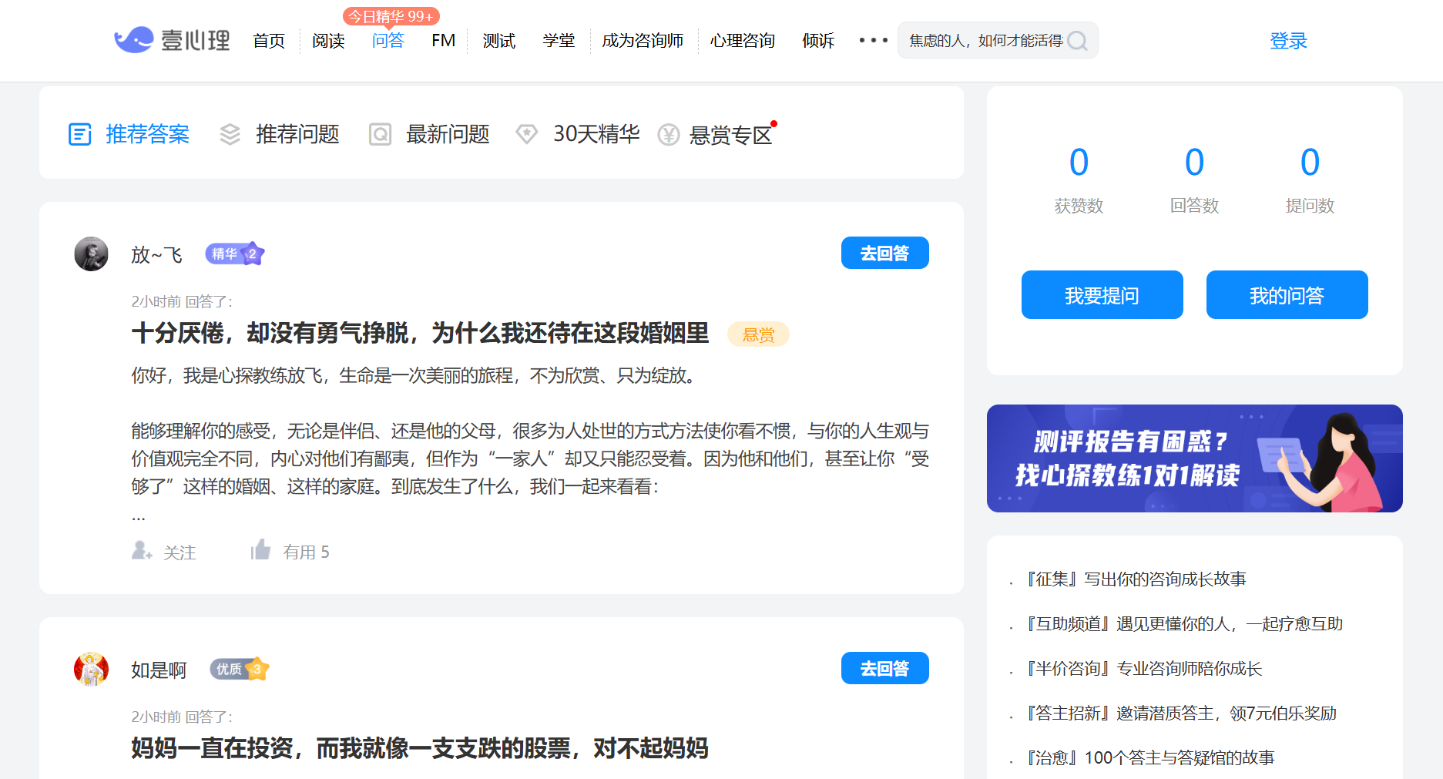

Slide 6
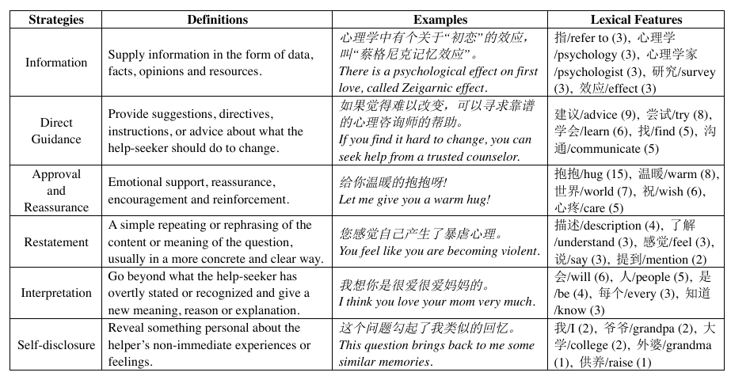
Data source
Authors annotated some of the QA pairs.

Slide 7
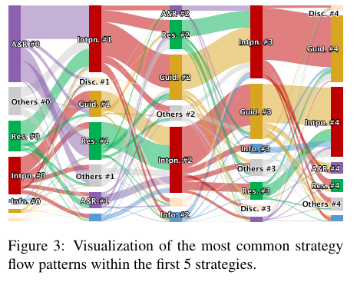
The dataset is of high quality
But its generalizability is still questioned

Slide 8
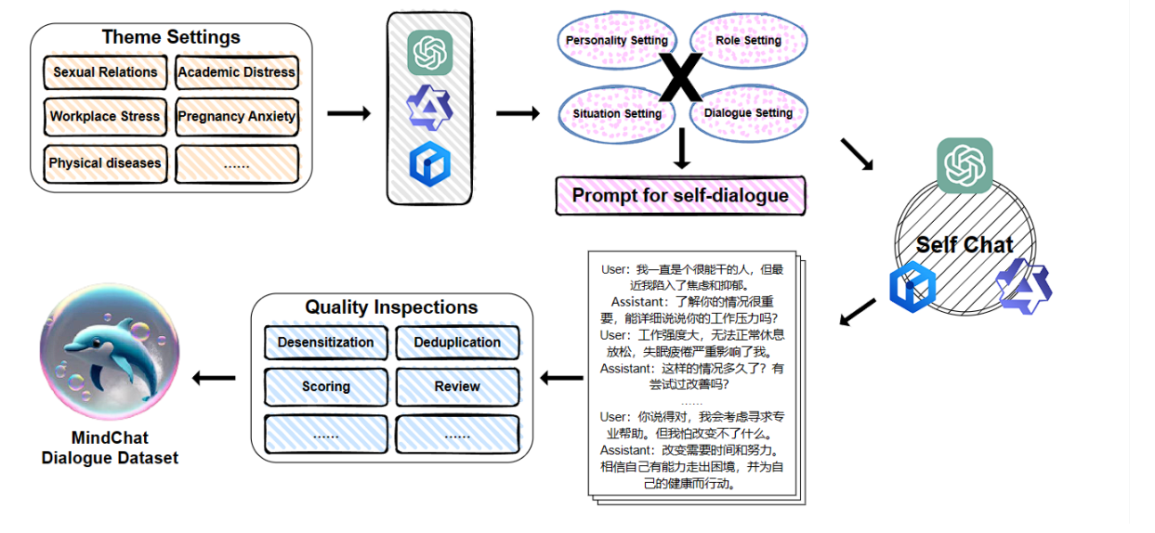
Other data source
MindChat: ChatGPT generation
QiaoBan: Not specified

Slide 9
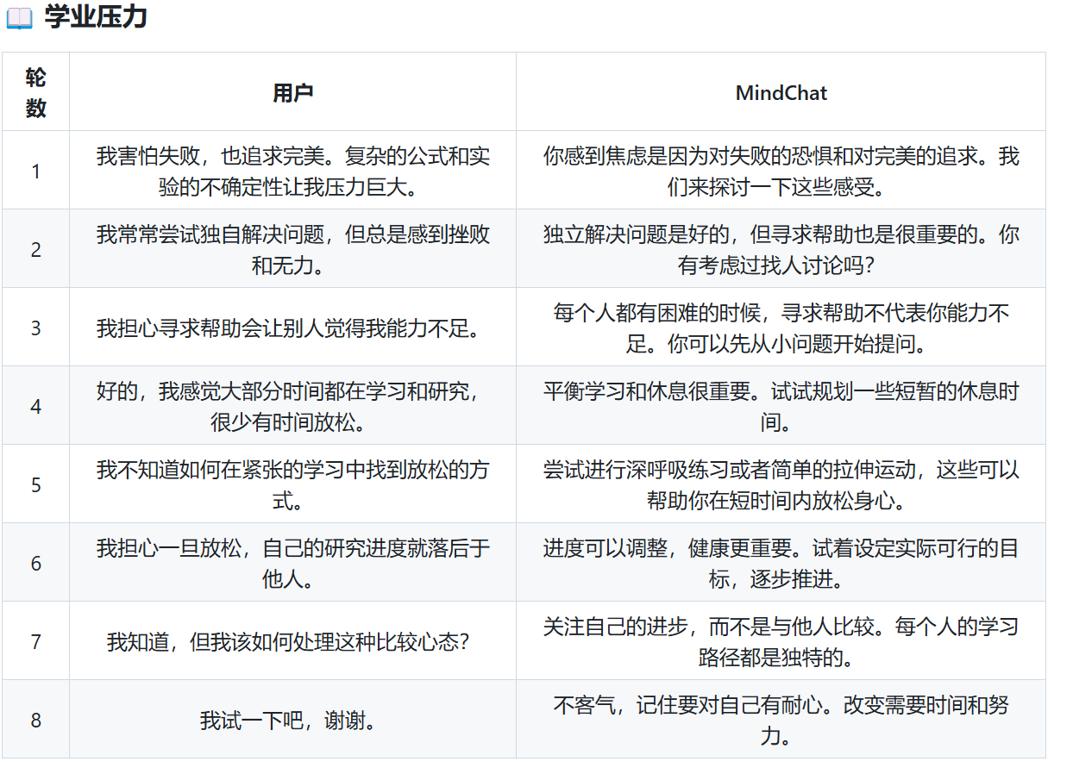

Slide 10
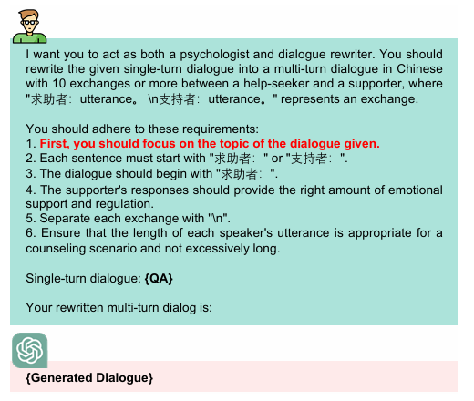
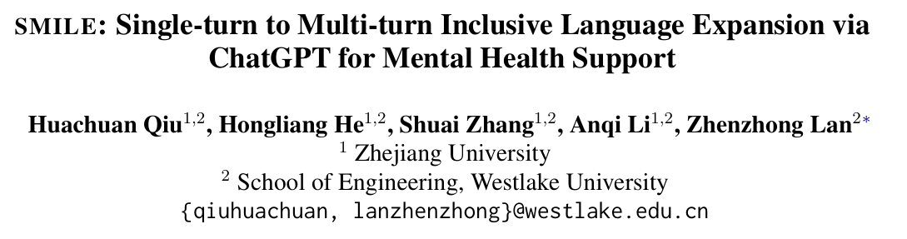
Data processing
MeChat:
Wording cleaning
Break long dialogue with the help of Chatgpt

Slide 11
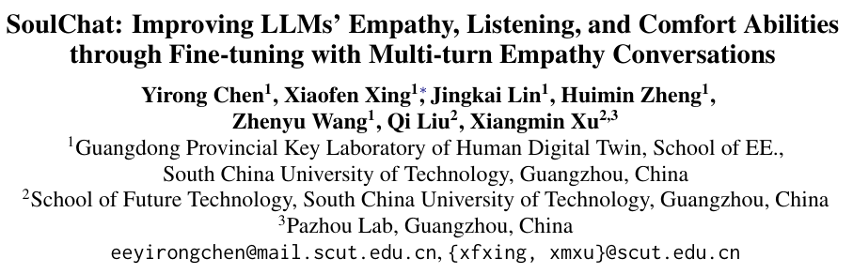
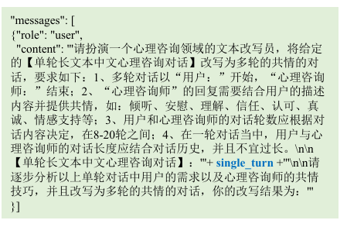
SoulChat tried to improve the prompt

